Slide 1
Projective Geometry and Camera Models
01/20/11
Computer Vision
CS 543 / ECE 549
University of Illinois
Derek Hoiem

Slide 2
Administrative Stuff
Office hours
Derek: Wed 4-5pm + drop by
Ian: Mon 3-4pm, Thurs 3:30-4:30pm
HW 1: out Monday
Prob1: Geometry, today and Tues
Prob2: Lighting, next Thurs
Prob3: Filters, following week
Next Thurs: I’m out, David Forsyth will cover

Slide 3
Last class: intro
Overview of vision, examples of state of art
Logistics

Slide 4
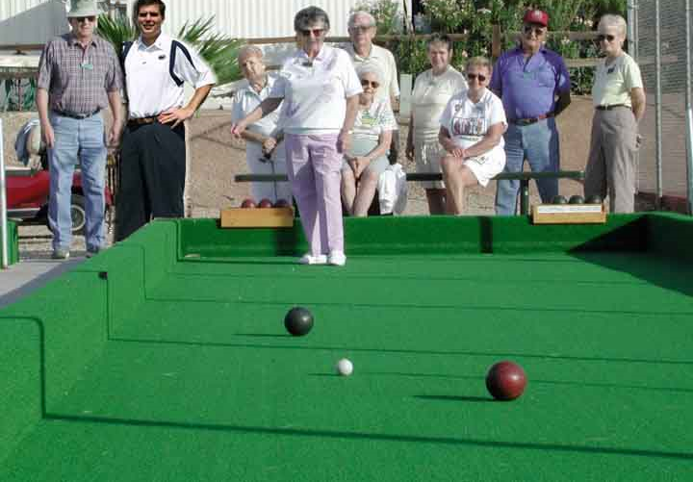
Next two classes: Single-view Geometry
How tall is this woman?
How high is the camera?
What is the camera rotation?
What is the focal length of the camera?
Which ball is closer?

Slide 5
Today’s class
Mapping between image and world coordinates
Pinhole camera model
Projective geometry
Vanishing points and lines
Projection matrix

Slide 6
Image formation
Let’s design a camera
Idea 1: put a piece of film in front of an object
Do we get a reasonable image?
Slide source: Seitz

Slide 7
Pinhole camera
Idea 2: add a barrier to block off most of the rays
This reduces blurring
The opening known as the aperture
Slide source: Seitz
Notes:
Q: How does this transform the image? A: It gets inverted

Slide 8
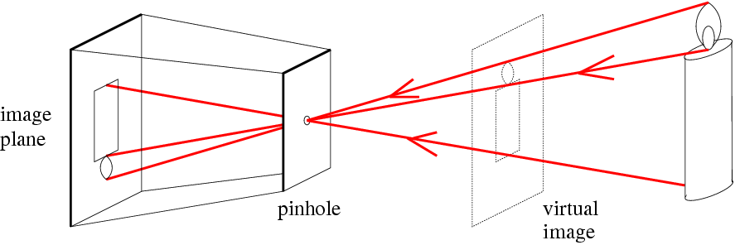
Pinhole camera
f
c
f = focal length
c = center of the camera
Figure from Forsyth

Slide 9
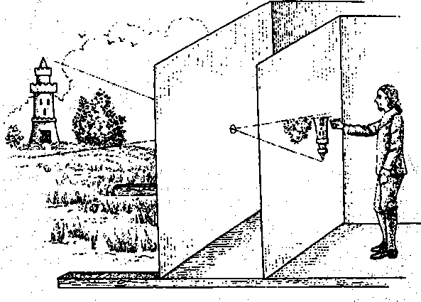
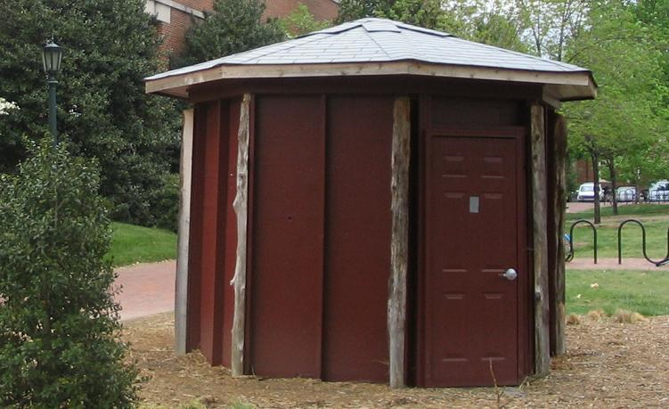
Camera obscura: the pre-camera
First idea: Mo-Ti, China (470BC to 390BC)
First built: Alhacen, Iraq/Egypt (965 to 1039AD)
Illustration of Camera Obscura
Freestanding camera obscura at UNC Chapel Hill
Photo by Seth Ilys

Slide 10
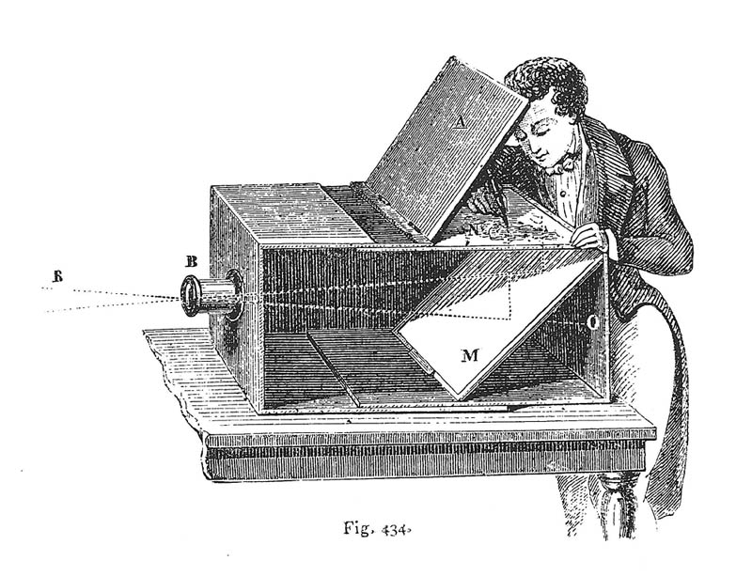
Camera Obscura used for Tracing
Lens Based Camera Obscura, 1568

Slide 11
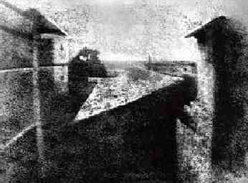
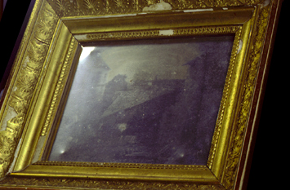
First Photograph
Oldest surviving photograph
Took 8 hours on pewter plate
Photograph of the first photograph
Joseph Niepce, 1826
Stored at UT Austin
Niepce later teamed up with Daguerre, who eventually created Daguerrotypes

Slide 12
Dimensionality Reduction Machine (3D to 2D)
3D world
2D image
Figures © Stephen E. Palmer, 2002

Slide 13
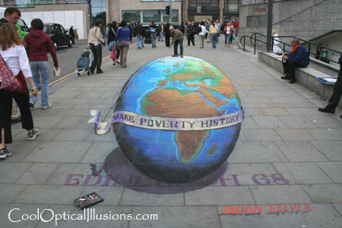
Projection can be tricky…
Slide source: Seitz

Slide 14
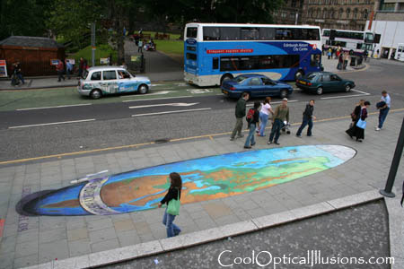
Projection can be tricky…
Slide source: Seitz

Slide 15
Projective Geometry
What is lost?
Length
Who is taller?
Which is closer?

Slide 16
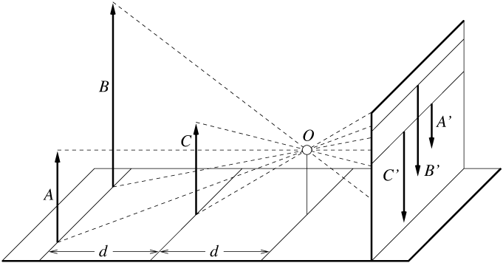
Length is not preserved
A’
C’
B’
Figure by David Forsyth

Slide 17
Projective Geometry
What is lost?
Length
Angles
Parallel?
Perpendicular?

Slide 18
Projective Geometry
What is preserved?
Straight lines are still straight

Slide 19
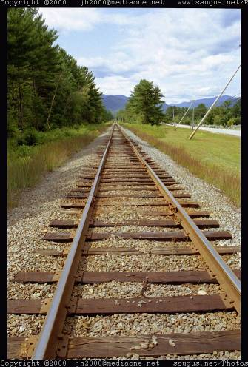
Vanishing points and lines
Parallel lines in the world intersect in the image at a “vanishing point”
Notes:
Go to board, sketch out various properties of vanishing points/lines

Slide 20
Vanishing points and lines
Vanishing Point
Vanishing Point
o
o
Vanishing Line
Notes:
Go to board, sketch out various properties of vanishing points/lines
Parallel lines intersect at a point
The intersection of red lines and blue lines form a parallelogram
Sets of parallel lines on the same plane form a vanishing line
Sets of parallel planes form a vanishing line
Not all lines that intersect are parallel

Slide 21
Vanishing points and lines
Vertical vanishing
point
(at infinity)
Vanishing
line
Vanishing
point
Vanishing
point
Slide from Efros, Photo from Criminisi

Slide 22
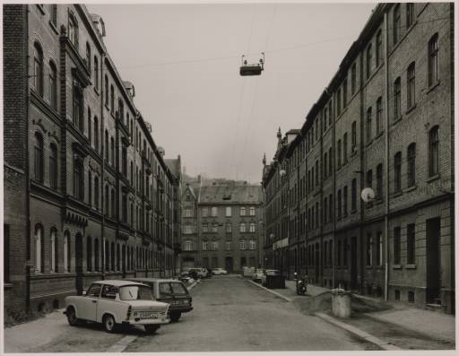
Vanishing points and lines
Photo from online Tate collection
Notes:
Where are the vanishing points? Do buildings on left and buildings on right have the same vanishing line? Which way is the camera tilted?

Slide 23
Note on estimating vanishing points
Use multiple lines for better accuracy
… but lines will not intersect at exactly the same point in practice
One solution: take mean of intersecting pairs
… bad idea!
Instead, minimize angular differences
Notes:
Go to board, sketch out various properties of vanishing points/lines

Slide 24

Vanishing objects

Slide 25
Projection: world coordinates→image coordinates
.
Optical Center (u₀, v₀)
.
.
f
Z
Y
.
v
Camera Center (t_{x}, t_{y}, t_{z})
u

Slide 26
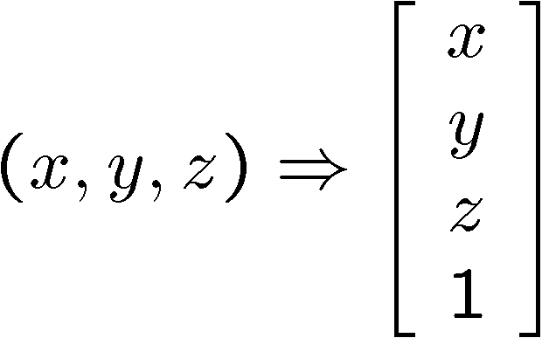
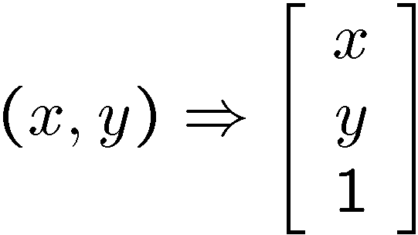
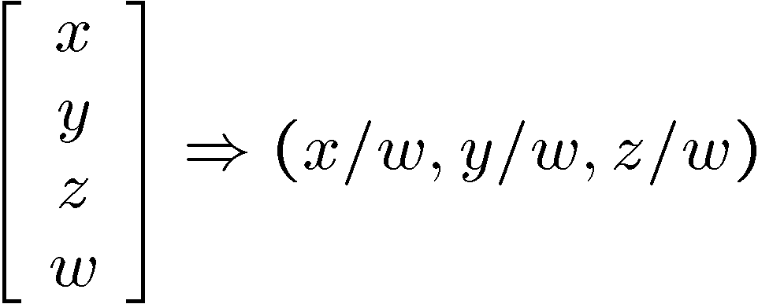
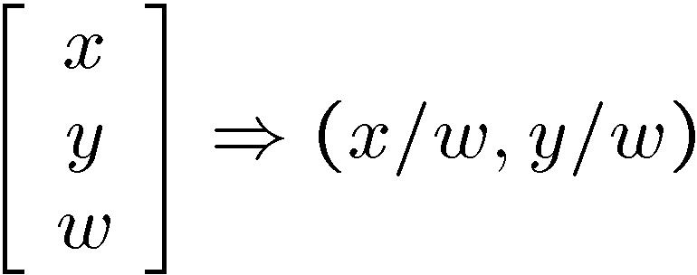
Homogeneous coordinates
Conversion
Converting to homogeneous coordinates
homogeneous image
coordinates
homogeneous scene
coordinates
Converting from homogeneous coordinates
Notes:
Append coordinate with value 1; proportional coordinate system

Slide 27
Homogeneous coordinates
Invariant to scaling
Point in Cartesian is ray in Homogeneous
Homogeneous Coordinates
Cartesian Coordinates
Notes:
Q: Suppose we have a point in Cartesian coordinates. What is that in homogeneous coordinates? A: a ray

Slide 28
Basic geometry in homogeneous coordinates
Line equation: ax + by + c = 0
Append 1 to pixel coordinate to get homogeneous coordinate
Line given by cross product of two points
Intersection of two lines given by cross product of the lines

Slide 29
Another problem solved by homogeneous coordinates
Intersection of parallel lines
Cartesian: (Inf, Inf)
Homogeneous: (1, 1, 0)
Cartesian: (Inf, Inf)
Homogeneous: (1, 2, 0)
Notes:
Parallel lines intersect at different infinities

Slide 30
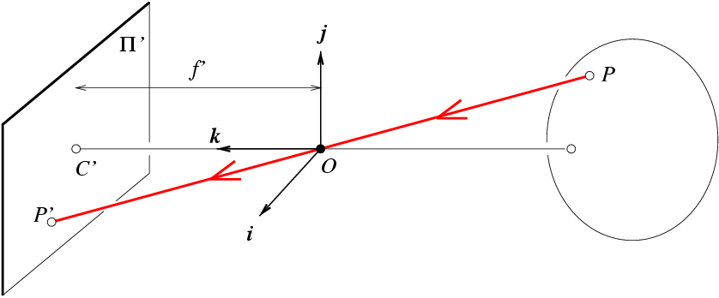
Projection matrix
Slide Credit: Saverese
R,T
j_{w}
k_{w}
O_{w}
i_{w}
x: Image Coordinates: (u,v,1)
K: Intrinsic Matrix (3x3)
R: Rotation (3x3)
t: Translation (3x1)
X: World Coordinates: (X,Y,Z,1)
Notes:
We can use homogeneous coordinates to write camera matrix in linear form.

Slide 31
Interlude: when have I used this stuff?

Slide 32
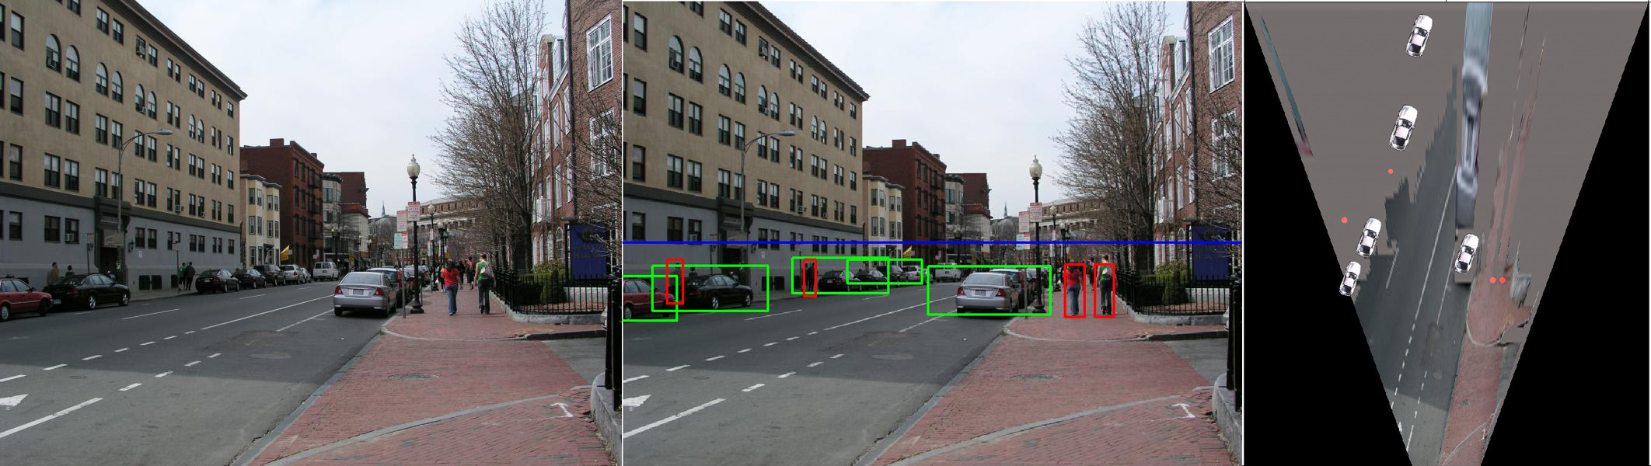
When have I used this stuff?
Object Recognition (CVPR 2006)

Slide 33
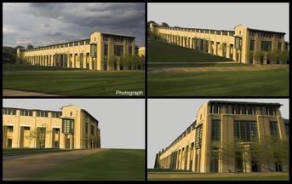
When have I used this stuff?
Single-view reconstruction (SIGGRAPH 2005)

Slide 34
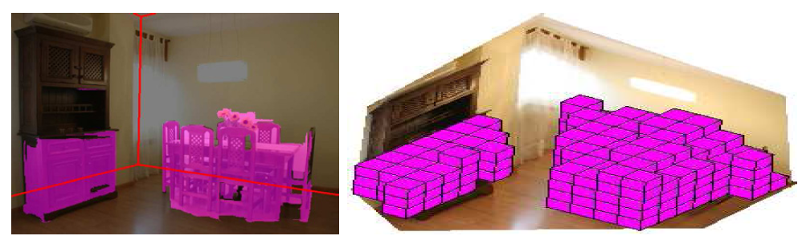
When have I used this stuff?
Getting spatial layout in indoor scenes (ICCV 2009)

Slide 35
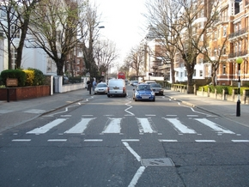
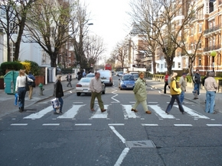
When have I used this stuff?
Inserting photographed objects into images (SIGGRAPH 2007)
Original
Created

Slide 36
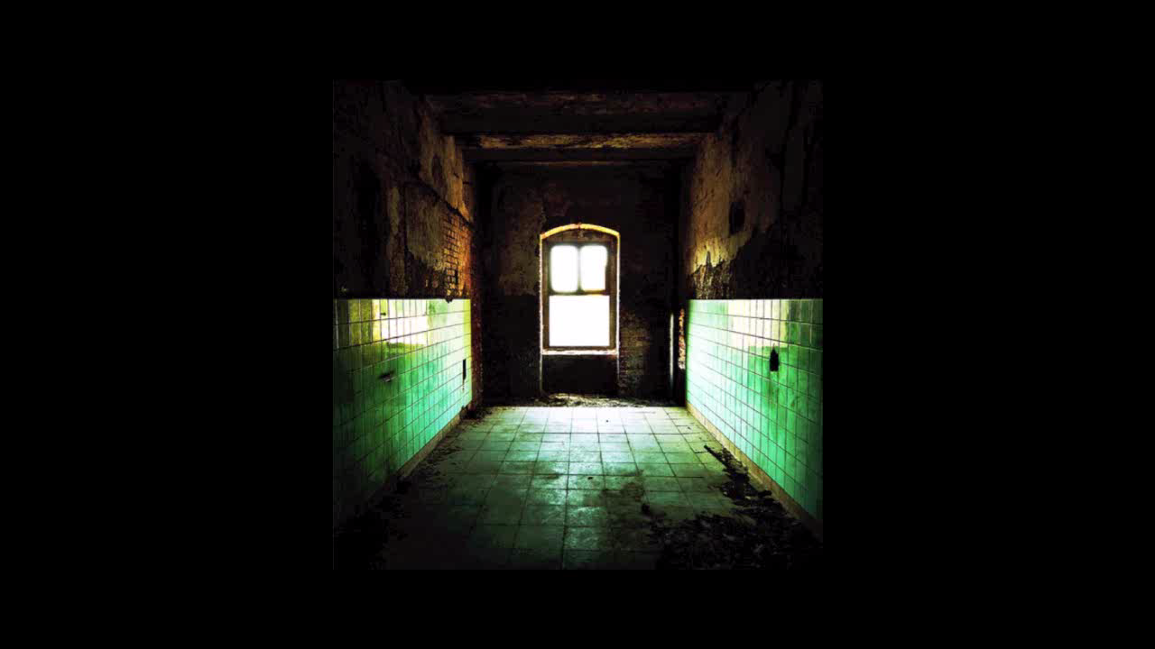
When have I used this stuff?
Inserting synthetic objects into images

Slide 37
Pinhole Camera Model
x: Image Coordinates: (u,v,1)
K: Intrinsic Matrix (3x3)
R: Rotation (3x3)
t: Translation (3x1)
X: World Coordinates: (X,Y,Z,1)

Slide 38
Projection matrix
Intrinsic Assumptions
Unit aspect ratio
Optical center at (0,0)
No skew
Extrinsic Assumptions
No rotation
Camera at (0,0,0)
K
Slide Credit: Saverese
Notes:
Work through equations for u and v on board

Slide 39
Remove assumption: known optical center
Intrinsic Assumptions
Unit aspect ratio
No skew
Extrinsic Assumptions
No rotation
Camera at (0,0,0)

Slide 40
Remove assumption: square pixels
Intrinsic Assumptions
No skew
Extrinsic Assumptions
No rotation
Camera at (0,0,0)

Slide 41
Remove assumption: non-skewed pixels
Intrinsic Assumptions
Extrinsic Assumptions
No rotation
Camera at (0,0,0)
Note: different books use different notation for parameters

Slide 42
Oriented and Translated Camera
R
j_{w}
t
k_{w}
O_{w}
i_{w}

Slide 43
Allow camera translation
Intrinsic Assumptions
Extrinsic Assumptions
No rotation

Slide 44
3D Rotation of Points
Slide Credit: Saverese
Rotation around the coordinate axes, counter-clockwise:
p’
γ
y
p
z

Slide 45
Allow camera rotation

Slide 46
Degrees of freedom
5
6
Notes:
How many known points are needed to estimate this?

Slide 47
Vanishing Point = Projection from Infinity

Slide 48
Orthographic Projection
Special case of perspective projection
Distance from the COP to the image plane is infinite
Also called “parallel projection”
What’s the projection matrix?
Image
World
Slide by Steve Seitz

Slide 49
Scaled Orthographic Projection
Special case of perspective projection
Object dimensions are small compared to distance to camera
Also called “weak perspective”
What’s the projection matrix?
Image
World
Slide by Steve Seitz

Slide 50
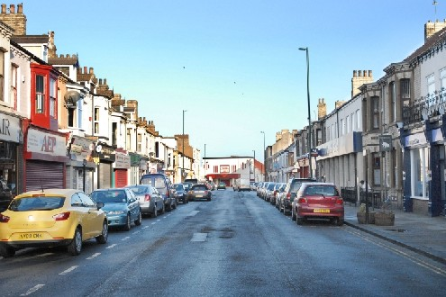
Suppose we have two 3D cubes on the ground facing the viewer, one near, one far.
What would they look like in perspective?
What would they look like in weak perspective?
Photo credit: GazetteLive.co.uk

Slide 51
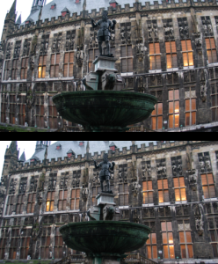
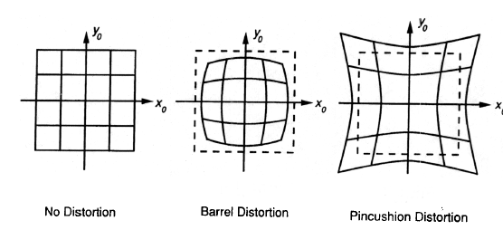
Beyond Pinholes: Radial Distortion
Corrected Barrel Distortion
Image from Martin Habbecke

Slide 52
Things to remember
Vertical vanishing
point
(at infinity)
Vanishing points and vanishing lines
Pinhole camera model and camera projection matrix
Homogeneous coordinates
Vanishing
line
Vanishing
point
Vanishing
point

Slide 53
Next class
Applications of camera model and projective geometry
Recovering the camera intrinsic and extrinsic parameters from an image
Recovering size in the world
Projecting from one plane to another

Slide 54
Questions

Slide 55
What about focus, aperture, DOF, FOV, etc?

Slide 56
Adding a lens
“circle of
confusion”
A lens focuses light onto the film
There is a specific distance at which objects are “in focus”
other points project to a “circle of confusion” in the image
Changing the shape of the lens changes this distance

Slide 57
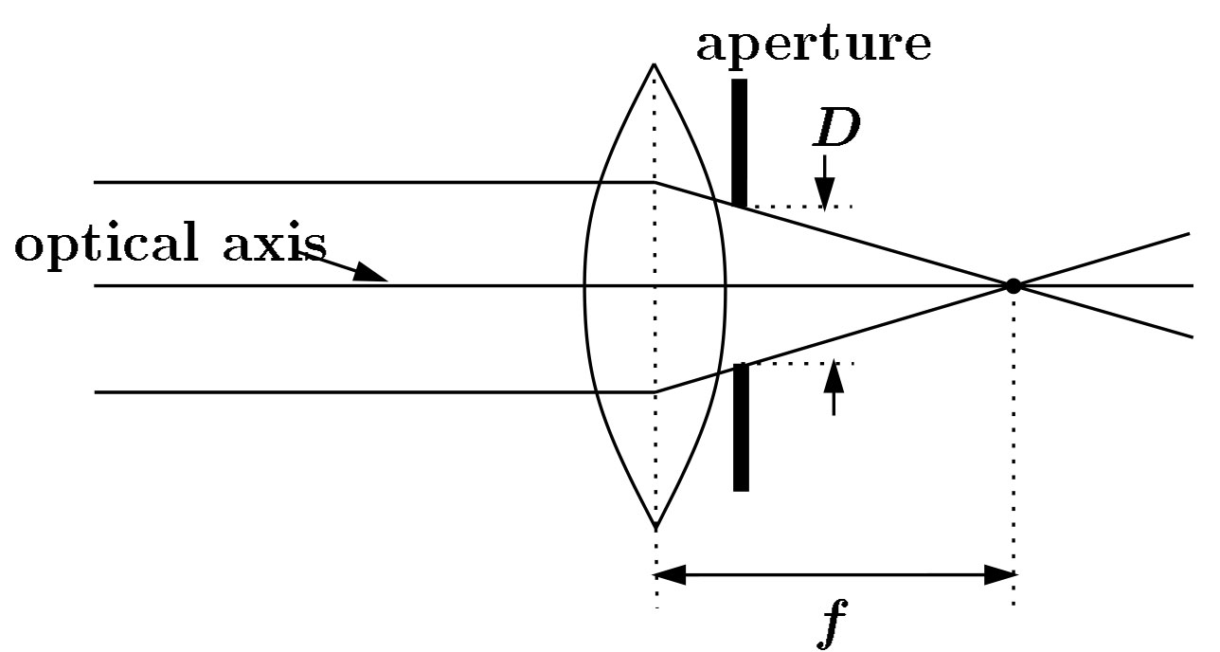
Focal length, aperture, depth of field
F
focal point
optical center
(Center Of Projection)
A lens focuses parallel rays onto a single focal point
focal point at a distance f beyond the plane of the lens
Aperture of diameter D restricts the range of rays
Slide source: Seitz

Slide 58
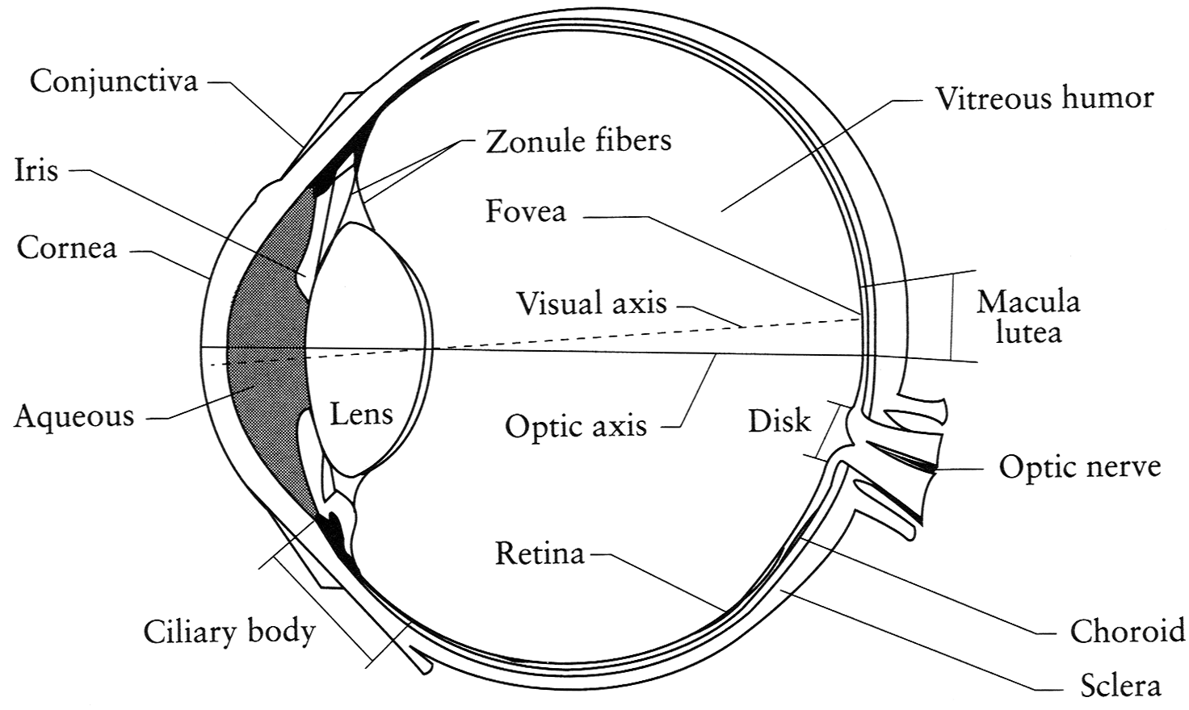
The eye
The human eye is a camera
Iris - colored annulus with radial muscles
Pupil - the hole (aperture) whose size is controlled by the iris
What’s the “film”?
photoreceptor cells (rods and cones) in the retina
Notes:
Note that the retina is curved

Slide 59

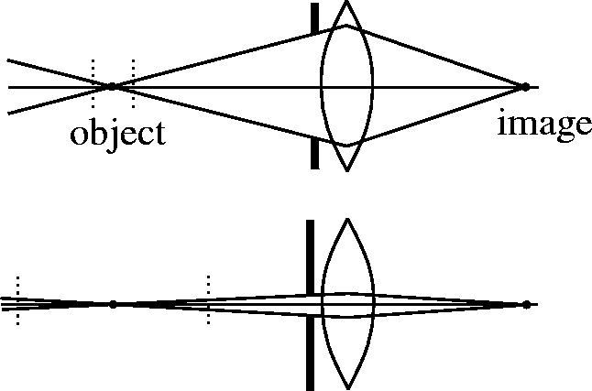

Depth of field
Slide source: Seitz
f / 5.6
f / 32
Changing the aperture size or focal length affects depth of field
Flower images from Wikipedia http://en.wikipedia.org/wiki/Depth_of_field

Slide 60
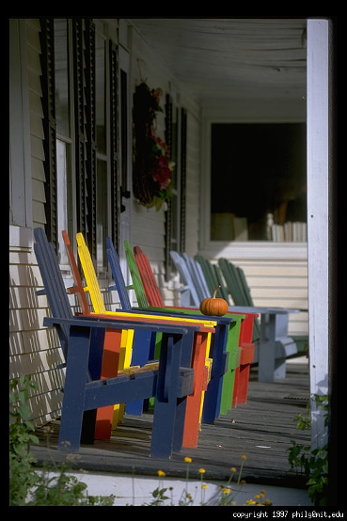
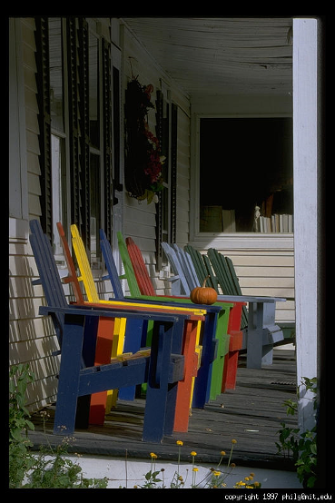
Varying the aperture
Slide from Efros
Large aperture = small DOF
Small aperture = large DOF

Slide 61
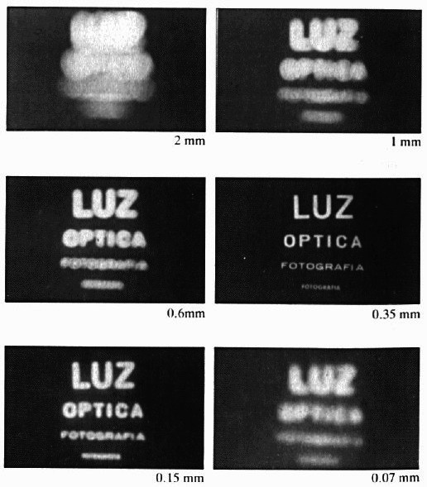
Shrinking the aperture
Why not make the aperture as small as possible?
Less light gets through
Diffraction effects
Slide by Steve Seitz

Slide 62
Shrinking the aperture
Slide by Steve Seitz

Slide 63
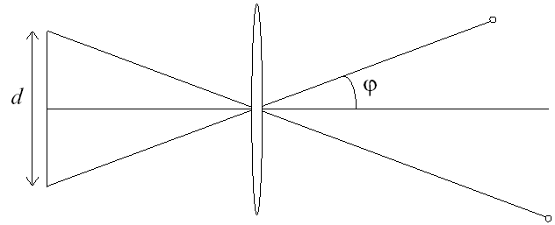
Relation between field of view and focal length
Field of view (angle width)
Film/Sensor Width
Focal length

Slide 64
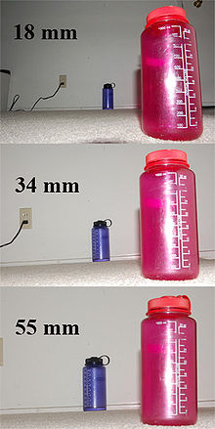
Dolly Zoom or “Vertigo Effect”
http://www.youtube.com/watch?v=Y48R6-iIYHs
How is this done?
Zoom in while moving away
http://en.wikipedia.org/wiki/Focal_length

Slide 65
Dolly zoom (or “Vertigo effect”)
http://www.youtube.com/watch?v=Y48R6-iIYHs
Field of view (angle width)
Film/Sensor Width
Focal length
width of object
Distance between object and camera

